Slide 1
Week 9
Progress Report and Testing

Slide 2
Team member
Front-end:
Tiansheng Liu 470342488
Fengjun Li 470342112
Yinan Chen 470041259
Kewen Su 470503539
Back-end:
Trung Kien Hoang 470020243
Xiaohan Li 470011746
Haozhe Zhang 460335162
Group 3 – Day Dream
Presenter – Tiansheng Liu 470342488
Fengjun Li 470342112
Haozhe Zhang 460335162
Project:
Web Platform for Client-Supplier Business Management

Slide 3
Front-end Development
Original Plan:
The web pages need to meet all basic requirements and be able to operate successfully in this week.
Problems:
Two difficulties: chat function and date filtering function.
Busy on developing and still not merging code.
Current Progress:
Complete the basic web pages with all requirements.
Transition from static pages to dynamic pages.
Try to overcome the chat function and date filtering function.

Slide 4
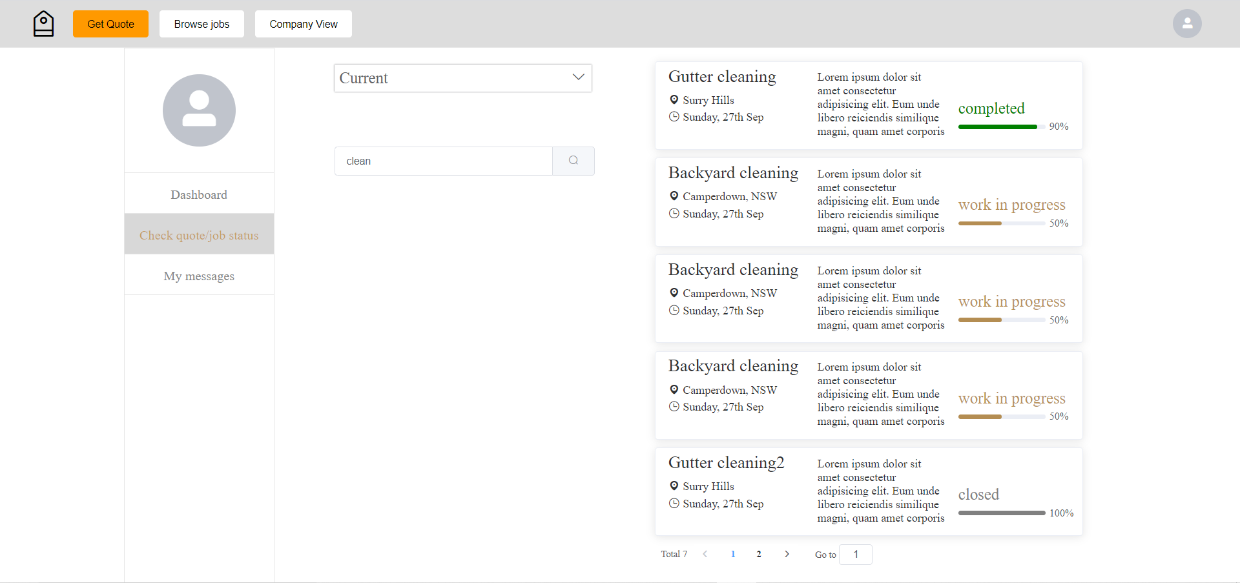
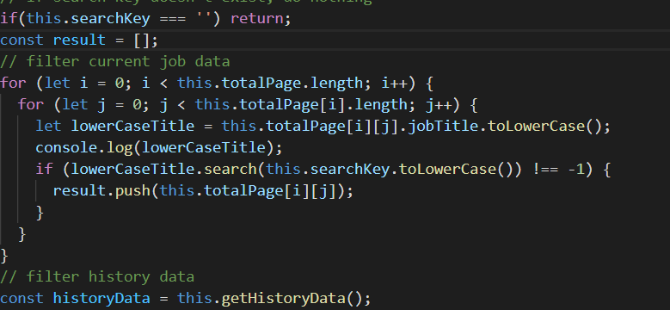
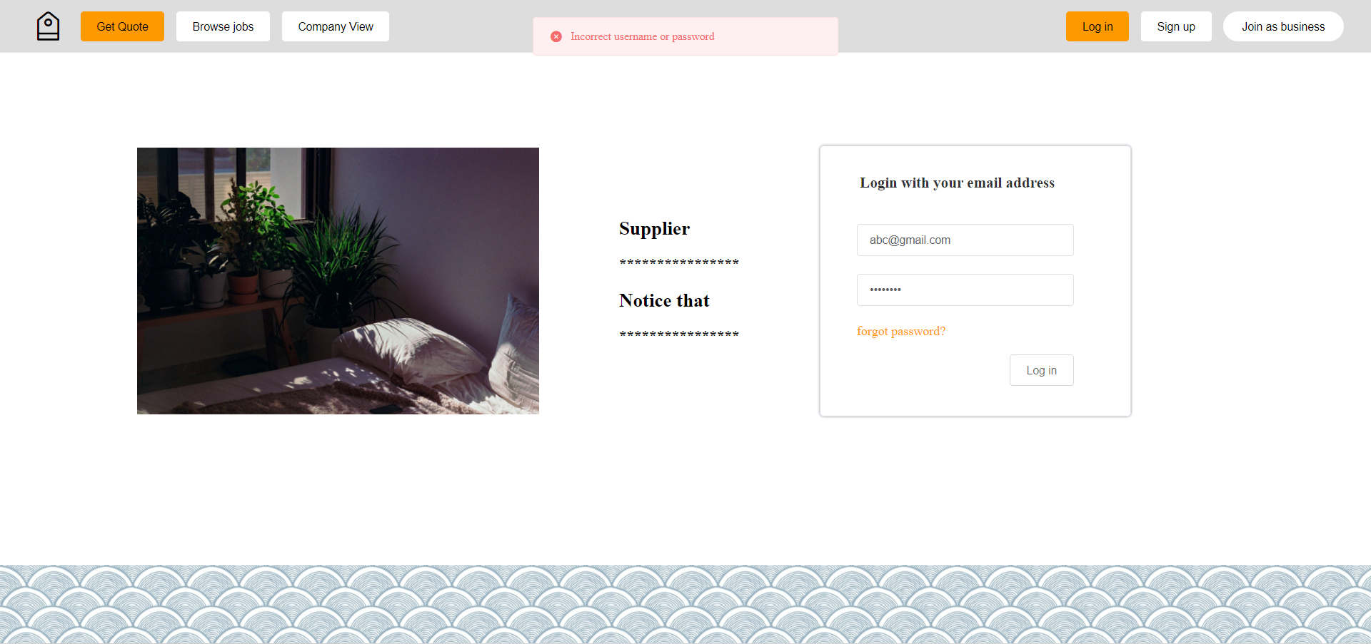
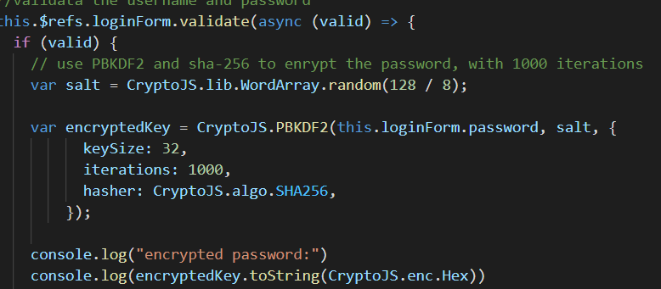
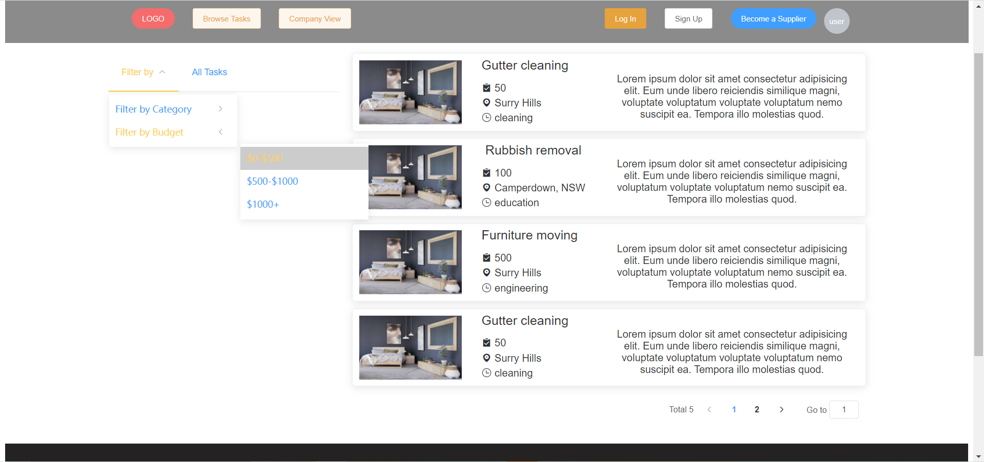
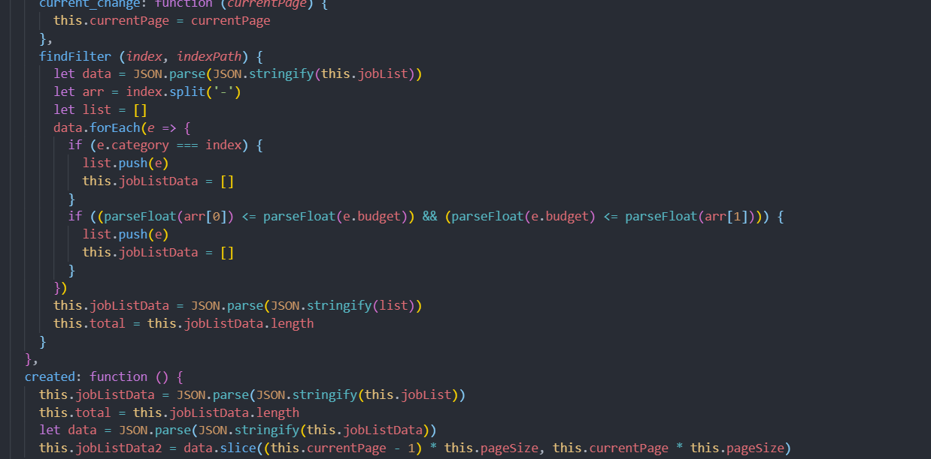
Search
Function
Account Encryption
Filtering
Function

Slide 5
Back-end Development
Original Plan:
Database can interact with front-end, it also can save and load data from front-end in week 8.
Problems:
The data interaction between the model and the database.
Successfully interact with the front end or not.
Current Progress:
Use the previously unified variable name to complete the database construction.
Start programming the functions which the back-end needs.

Slide 6
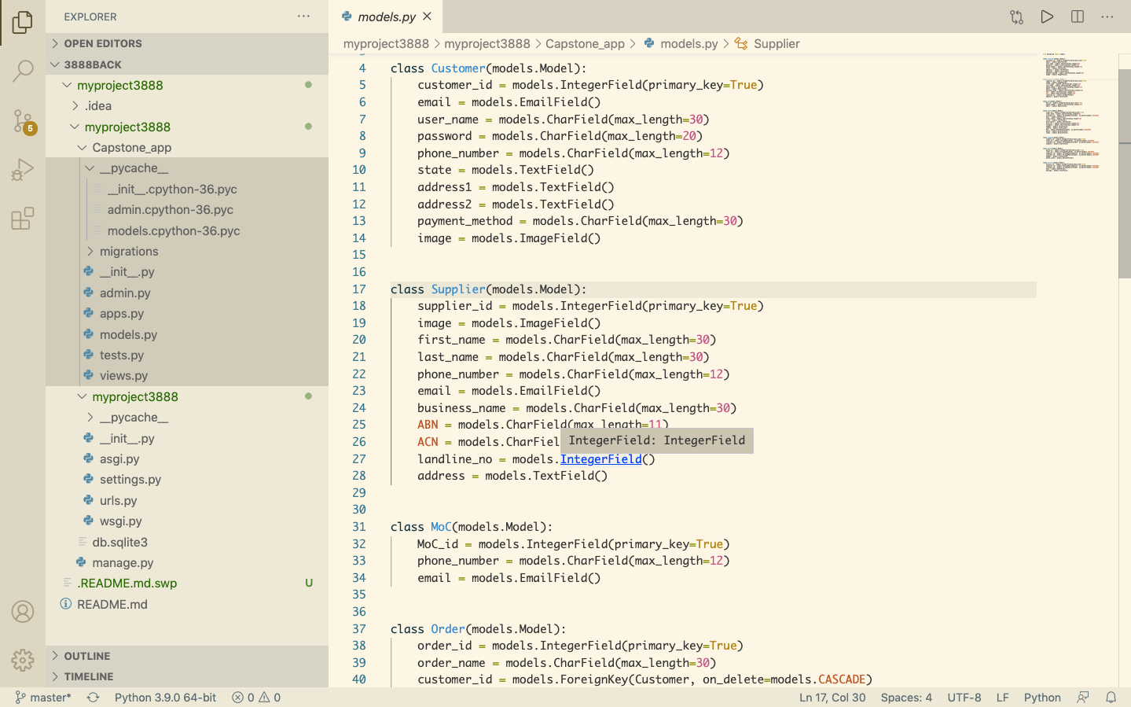
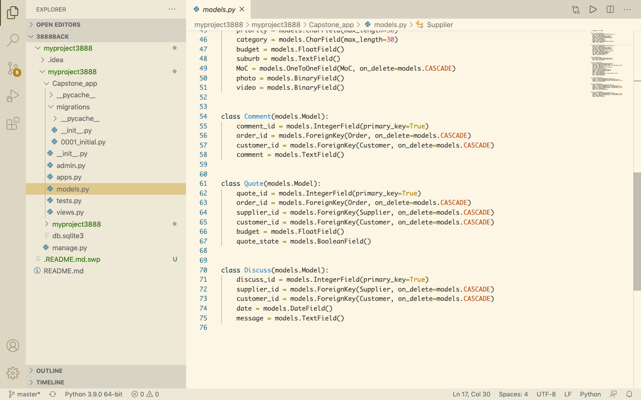
Database Construction

Slide 7
Details of Testing Strategy
1.Create the prototype testing plan
Plan will include objective or questions; the method we intend to use to test prototype; the number of users we’ll test on; a list of all the equipment we’ll need; and how we’ll document and measure findings. 2.Recruit participants
Test on users who represent our target audience.
3.Gather all the necessary equipment
Refer back to the plan and make sure got everything need to conduct the tests: screen recording software,pens and paper,ets. 4.Document our findings
Record each test in order to analyze the observations and compare the results of each session.

Slide 8
Product Evaluation
Plan A: We show our product remotely though ZOOM (We Prefered）
More space to display the function for our web application
Able to show more product detail
Plan B: Client run product on his local server
Client can experience product more intuitively
Client can find more detail and logic in our code

Slide 9
Test Scenarios
Step1: introduction of product function and interface
Step2: Simulate the whole process of a new user using our web application
Step3: Answer the question and get feedback from our client

Slide 10
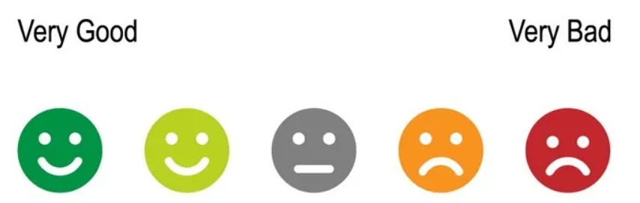
Performance Variable and Score
Performance variable:
Function and interface can meet client requirements
speed of retrieval
The aesthetics of the interface
Function and interface are user-friendly
How to Score: 5-Level

Slide 11
How to determin successful or not?
Concept validation -Verifying if people can quickly figure out what they are looking at and what it does.
Navigation -Test whether people can find what they think they’re going to find based on the categories present.
Flow of specific features/ functionalities -Does the prototype flow smoothly or mekr the user confused?
Microcopy -Put real labels, menu categories, button names and short descriptions on the prototype, to check the user reaction towards the words/texts (also professionally called “Microcopy”)

Slide 12
THANK YOU！

